Slide 1


ProtectedU
Chiao Lu, Shen Teng, Mu-Te Shen, SangJi Lyu
CS M117
Spring 2018
June 6th

Slide 2
Abstract
Through continuous invention and renovation of technology, identifying yourself has become easier than ever before. Unfortunately, impersonating someone has become easier as well. As long as one has your physical identification card, they can pretend to be you. For example, the barcode on our UCLA ID card is simply plain text encoding of our ID number. To make the hacking process even simpler, one can take a picture of that barcode, and do a lot of things in the name of you, without being noticed since the card is not “lost.” Our goal is to propose a new way of identification with the security that algorithm can provide. Each time a student needs to pull out their ID, like in the dining hall or at libraries, they can either use the generated QR code, or use the NFC (simply tap) to connect with the receiver. With our app, one doesn’t have to worry about lost ID, or malicious copying of the ID.
Notes:
-We built an application that tackles ID theft. IMPORTANCE OF ID…..Libraries, debitcard, etc.
-Very easy to steal ID and the barcode on our UCLA ID card is simply plain text encoding of our ID number.
Our goal is to propose a new way of identification with the security that algorithm can provide. Each time a student needs to pull out their ID, like in the dining hall or at libraries, they can simply tap their phones to connect with the receiver.
Our service/application will constantly create a string hashed from the ID number, timestamp, and secret salt every once in a while, and that’s the only valid ID a student can use. Making it more secure

Slide 3
Theory
Near Field Communication (NFC). Specifically, Peer to Peer NFC. This was done to achieve maximum security for our app. In our application, we worked closely with Android; thus, used a feature in Android (mobile) operating system called Android Beam. Android Beam authorize data exchange via NFC, and allows one to read NDEF messages from other NFC device.
SHA-256 Cryptographic Hash Algorithm. We used SHA-256 to generate a unique 32 byte signature for the student’s ID. This is useful as hash is a one way function; thus, near impossible to be decrypted to the text it once was. Our app also adds a timestamp and a secret salt to the hashing, and the salt is known only to the server and the specific student. The timestamp adds the security so that the generated hash string cannot be reused by a theft.
Google Cloud Platform and NoSQL were both used for, mainly, data storage and retrieval of data. Google Cloud Platform was used for database (students information) and server purpose.
Notes:
In peer to peer mode, devices are connected through physical contact, and allows exchange of information in adhoc style.

Slide 4
User flow
Registrar create user
With student’s name and email
Student verify their identity
The vcode is only valid for 5 minutes
Obtain student id and salt after successfully verified
While student wants to checkout books
Student sent the primaryKey and hashed student ID to scanner
Scanner sent the information to the server to verify, and return with true/false.

Slide 5
Video Demo
https://youtu.be/bVTEiDR5GSE

Slide 6
Frontend - Design
Register (put student information in database)
Scanner
Scanner (authenticate student id)
Scennee
Student (go to register to sign up; go to scanner to authenticate)

Slide 7
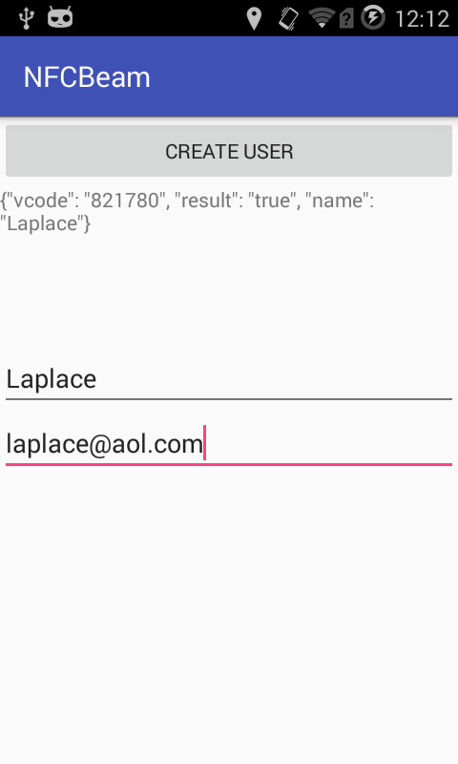
Frontend - Register
A “name” field and an “email” field
Click “CREATE USER” button, and the register app will contact Google Cloud Platform (GCP) to input the student info.
GCP will return a “vcode”. This “vcode” is then handed to the student. The student uses this vcode to setup the scannee (student id).
“Result” field tells the register if “create user” is successful

Slide 8
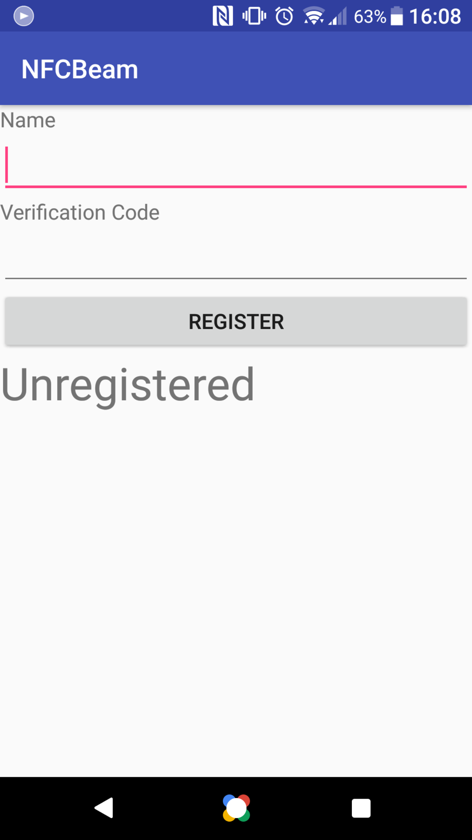
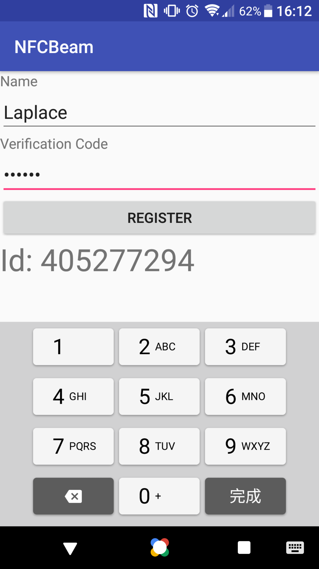
Frontend - Scannee
First time open app (left pic): student will take the vcode from register (prev slide) and setup his app (student id)
Student id number will be returned from the server and displayed on the text box below.
After setting up, when the student wants to have his ID scanned, for example to check out a book from library, he can open his app and bring the phone close to the scanner. The scanner will verify if the ID is authentic or not.

Slide 9
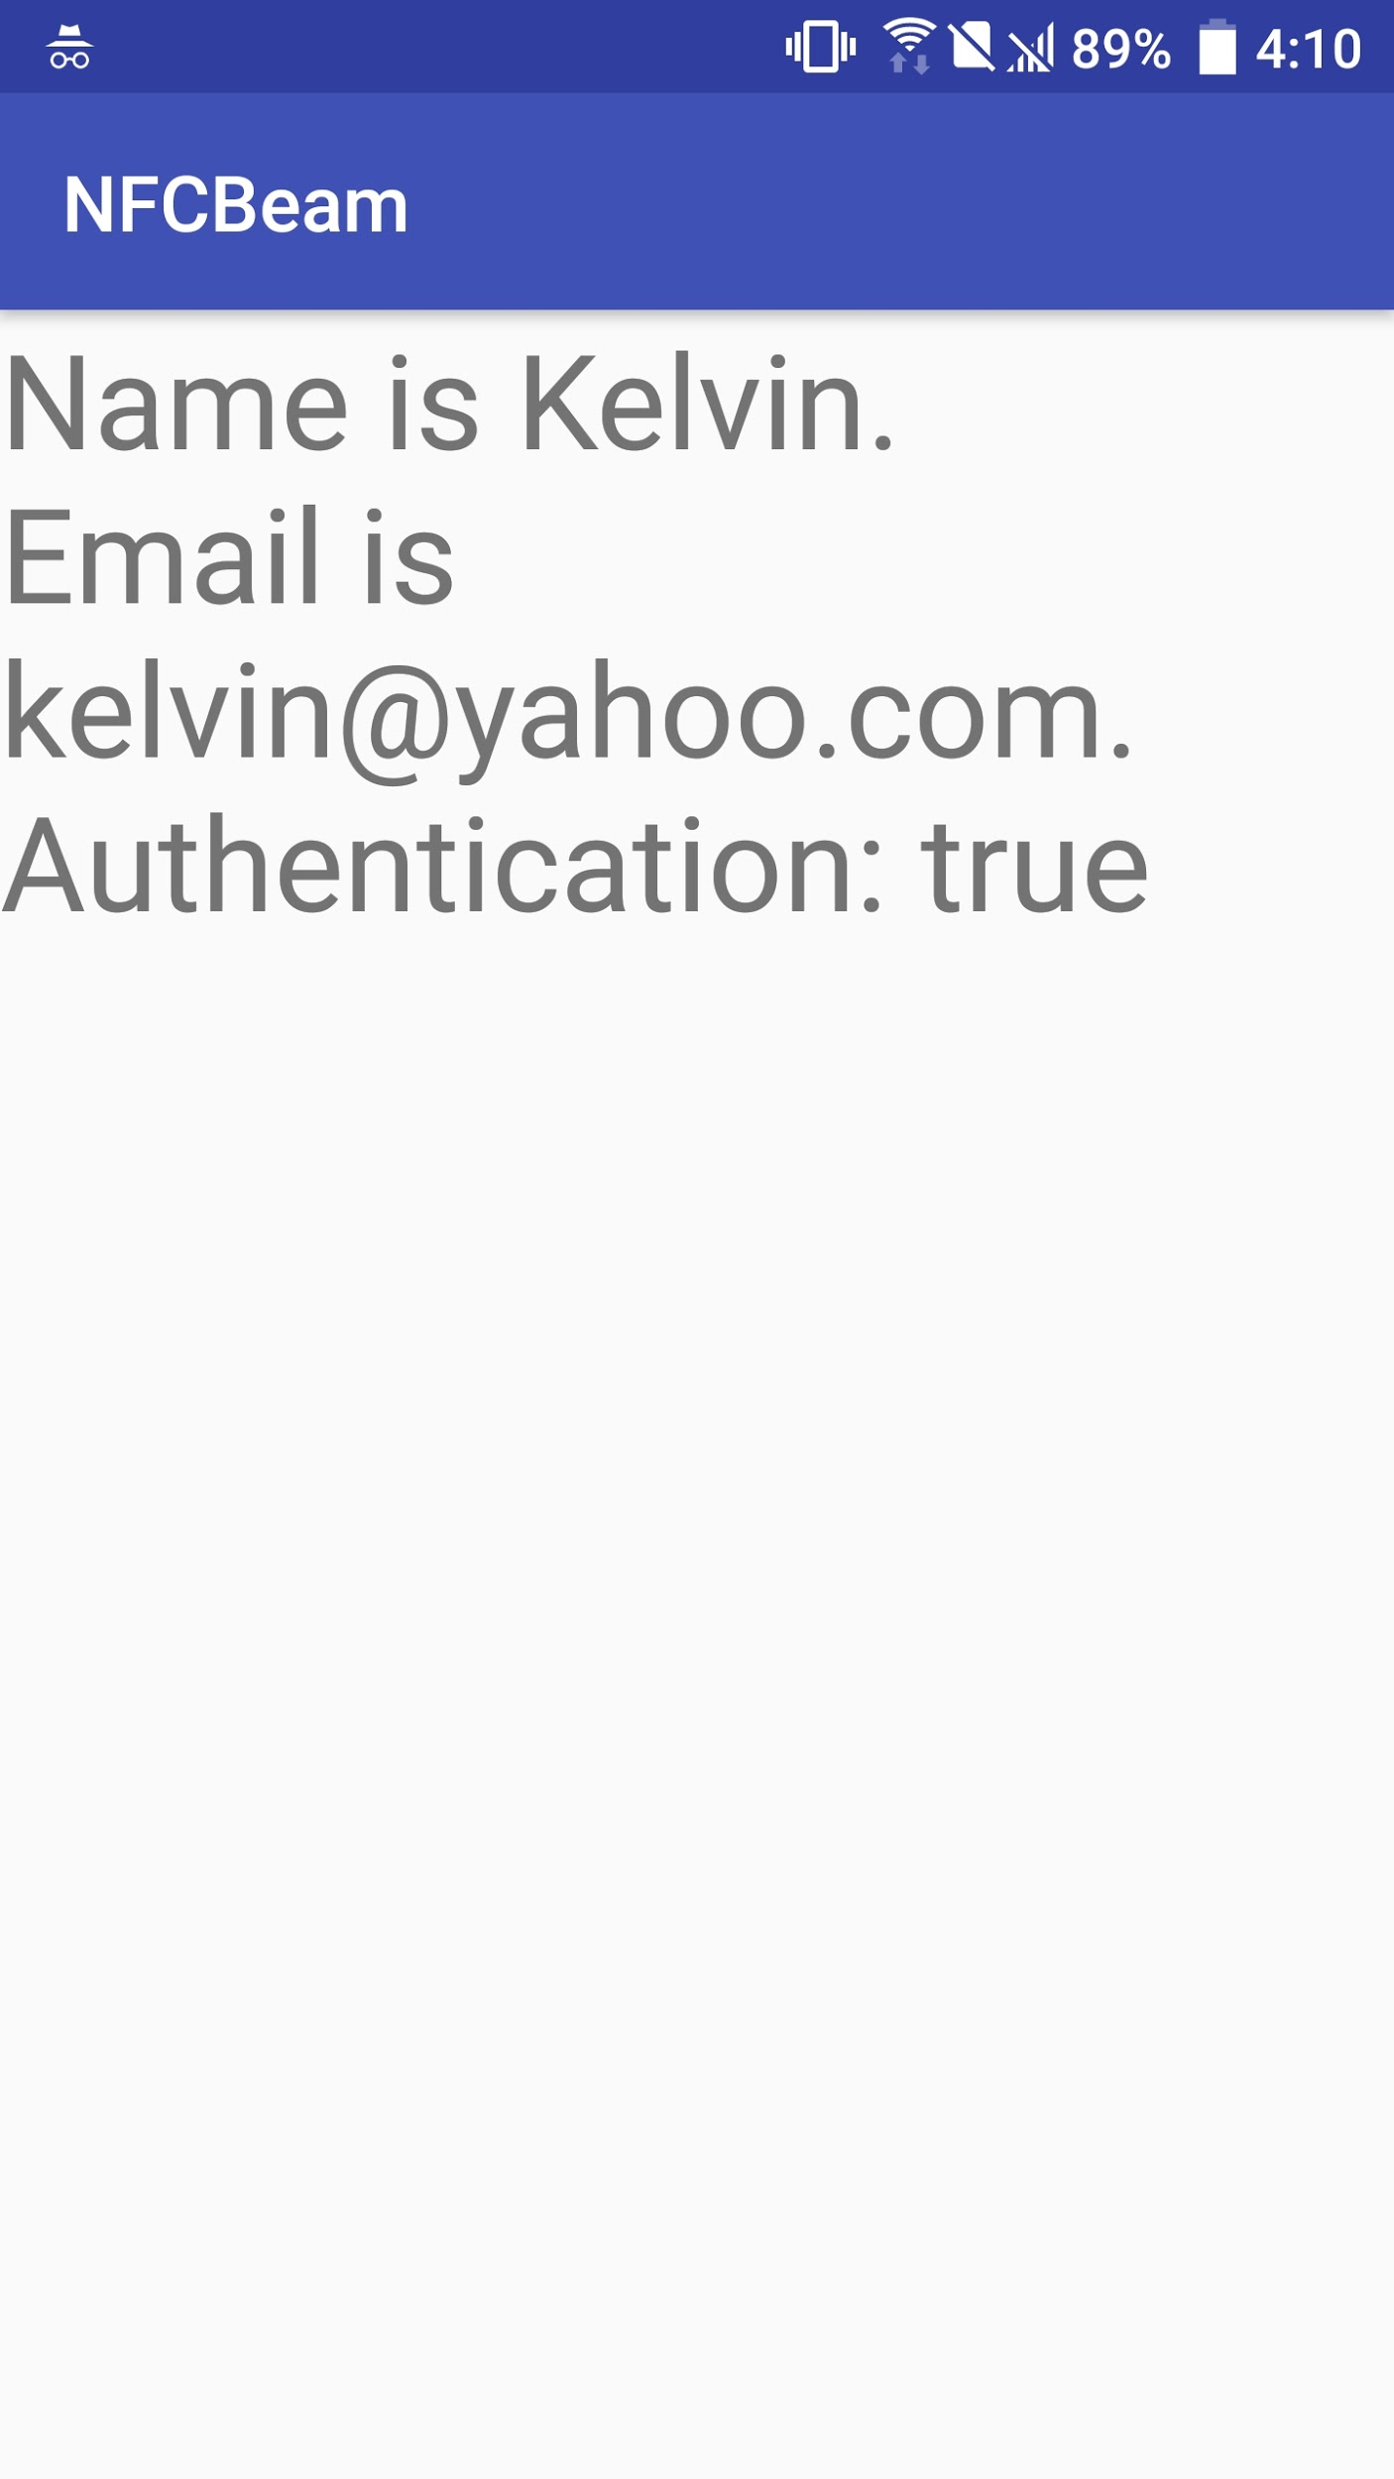
Frontend - Scanner
The student will bring his phone physically in contact with the scanner. The scanner will use NFC to scan the student’s phone.
After scanning the student’s phone, the scanner app will contact GCP to verify if the student’s ID is authentic or forged.
We prevent fraudulent verification by sending a SHA256 hashed string which includes the student id number, secret salt, and timestamp.

Slide 10
Backend - Design
Server
Python Flask
URL routing
HTTP server
Google Cloud Platform App Engine
Database
Google cloud storage
NoSQL

Slide 11
Backend - API
/createuser
Input: name, email
Output: result, vcode
/verifyuser
Input: name, vcode
Output: studentID, primaryKey, salt
/verifyid
Input: primaryKey, IDHash
Output: result, name, email

Slide 12
Discussion
Grace period during the first 5 seconds of each minute
Secret salt to add security
Hash results change with time

Slide 13
Conclusion
Overall, our application is built to keep student’s life and identity safe. At school no one should worry about their safety. With combination of Near Field Communication (NFC) and SHA-256 our application is built to have security, and in turn keep your Student ID safe.

Slide 14
Questions?

Slide 15
Thank you!

